Slide 1

How to present yourself
Workshop 1 Hack your future

Slide 2
Intro
Who are we
How to present yourself online
How to present yourself in real life
Examples
Outro

Slide 3
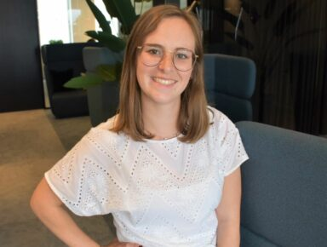
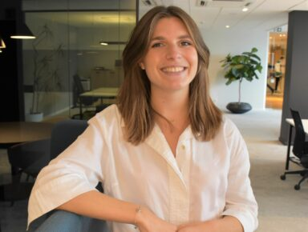
Who are we?
Lorine and Laurien from AT recruitment
HR consultants specialized in IT and digital profiles
What will we contribute
How to present yourself
CV training / Linked In
How to navigate the Belgian job market
Interview training
laurien.vandonick@atrecruitment.be
lorine.pulmans@atrecruitment.be

Slide 4
How to present yourself
Online
Must Haves
Who are you
Personally: your story (soft skills)
Professionally: hard skills
What are you doing right now
Highlight the value of HYF
What did you learn
Motivation to join
Where do you want to go
Let people know what you want in the future
What can you contribute
Notes:
Think about the company you’ll be working for
what can i contribute to this company
you start from the company’s perspective
mnetion laguages and level

Slide 5
How to present yourself
Online
Nice To Haves
Present yourself through a picture
professional
Have a tagline
Who are you in 1 or 2 sentences
How can we contact you?
e-mail: professional
LI profile
Link your previous work
references?

Slide 6
How to present yourself
In real life
Dress appropriately
Read through company website and vacancy
Know who you will meet
Body language
To the point
Notes:
after the online introduction to a company you’ll hopefully get the chance to meet them in person (or via online meeting)
the more extended interview workshop will take place in the beginning of next year but i’ll give you some tips right now to prepare on presenting yourself in real life to companies
for this part, it’s important to present yourself professionally and convince the company that you’re the right person to hire
Some things we think are helpful are the following
dress appropriately: sometimes it’s a bit hard to estimate whether the environment is very formal, less formal or rather casual. sometimes the company website can help to know the vibe of the company. If you are in contact with a recruitment agency like ours it’s always possible to ask the recruiter. He of she can help you with the dress code for interviews.
read through webiste and vanancy: come prepared is the most valuable tip I can give you. There’s nothing worse than attending an interview and not knowing what the company does, stands for and the vacancy you applied for. It’s obviously possible you apply for different positions at the same time but it’s important to prepare each interview properly. It is best to look for the company website, read their values, mission statemants etc. This can also help you to assess whether you match the company value-wise. After the website, look for them on other platforms like for example linkedIn. this will give you som extra info on their culture, vacancies, important milestones etc.
read through the vacancy is probably the most thing you can do in preparation for a real life interview
know the title, read through the description and prepare some questions
companies always find it interesting when candidates have their own questions about the vacancy, job description, culture etc
it shows you have an genuine interest in the company
know the people you meet
when applying for a job you get to meet different people through the hiring process
It’s very helpful to know which people you’ll meet in interviews
depending on the person you can adapt questions you would like to ask
some companies always start with someone from HR - this person is often not very IT technical and will focus more on your personality and competencies
body language:
don’t cross your arms
adapt to the person sitting in front of you - it’s proven that copying someone’s body language helps to create a bond
make eyecontact but not too much
come to the point
keep it professionally
it is important to come to the point when getting asked a questions
a first interview is not the time and place to tell your whole personal life
but it IS important to present yourself enough and highlight your knowledge and added value for the company

Slide 7
Other tips to prep your interview
Make sure you arrive 5-10 minutes before your interview
Prepare your travel time/online meeting set-up
Have an emergency contact number
Notes:
it’s possible the building is big and you don’t know exactly where you need to be, you don’t find a parking spot or your bus arrives a little later than expected
it gives you the time to settle, absorb the atmosphere in the company and calm down before the interview
prepare your travel: where am i going, what’s the address, is it a joined buildig (which floor), are there different sites,...
set up your online meeting: good background, dressed appropriatly, good connections, camera test, head set test, not to much background noise,...
have emergency contact number: when something happens, make sure you have a direct phone number of someone involved in the meeting
someone from the recruitment agency
HR, IT, ….
itt’s very important to contact them is you’re for example running late, can’t find the exact place you need to be
Always try and find the right place by yourself, talk to someone that’s passing by, the receptionist - it shows independency which is a valuable asset that companies appreciate

Slide 8
Examples
Examples of good and bad resumes
there is NO one-size-fits-all
Think about what the company wants to read
When you say you are a good communicator - explain!
What can you add to the company vs. what I can offer
Phrases to use: i excel at, i master rather than i’m good at
Give examples
e.g. projects you worked on, internships, papers,...
Notes:
what i look for in a good resume
not too much text - your resume is to highlight your most important accomplishments
in an interveiw you’ll get the chance to talk more detailed about your experiences
try to avoid time gaps in your resume
easy to find contact details
depending on the kind of job you’re looking for you can adapt the lay-out
e.g. very graphic job - add some graphic details
e.g. corporate job - very professional, professional photo,...
there is no one-size-fits-all - i can only give you some tips and tricks but one resume might work for one company but might not work for another one
think about the companies perspective and what you as a person can add
e.g. you are communicative - explain with a specific work-related (or private) example
explain why this is a valuable asset for the company
company’s perspective: what you can offer might not always be valuable to the company
e.g. you prefer to work independent but the job requires continuous teamwork
ASK: could you give me some of your strong competencies
how can you turn them into a valuable asset for a company
why is this something that can add value to a company or job

Slide 9
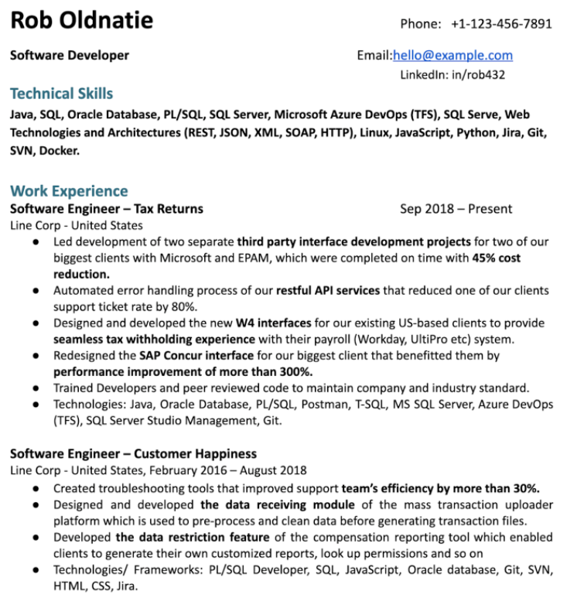

Slide 10
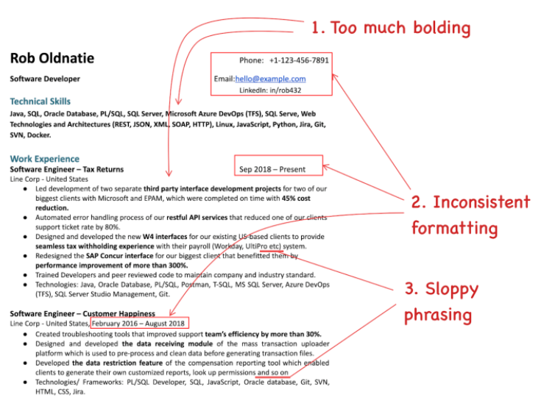
Notes:
to much bolding
inconsistent formatting
sloppy phrasing
a lot of text

Slide 11
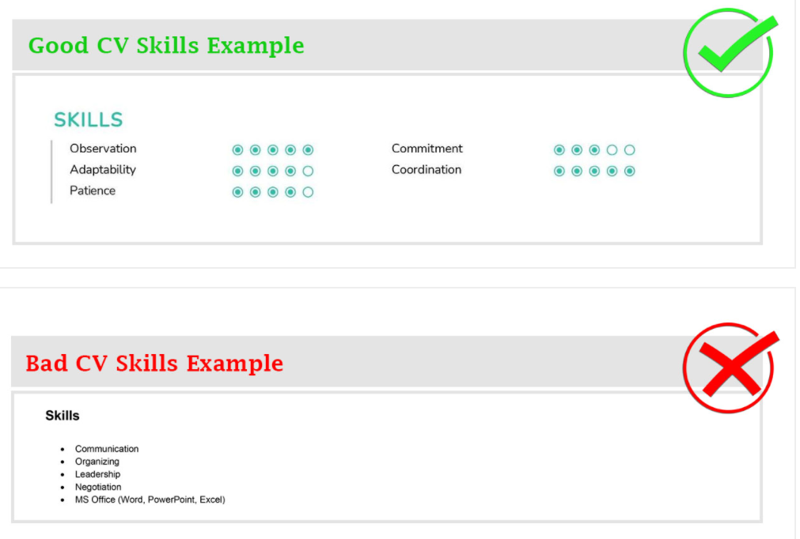
Notes:
visualize your skills
companies and recruiters see a lot of resumes a day, a year
when a skill is important for the vacancy they want to immediately see your skil level
choose for unique competencies like loyalty, commitment, trustworhty,...
make sure you can give an example for eacht of the competencies - a lot of companies ask for specific examples when or where you have obtained a certain skill

Slide 12
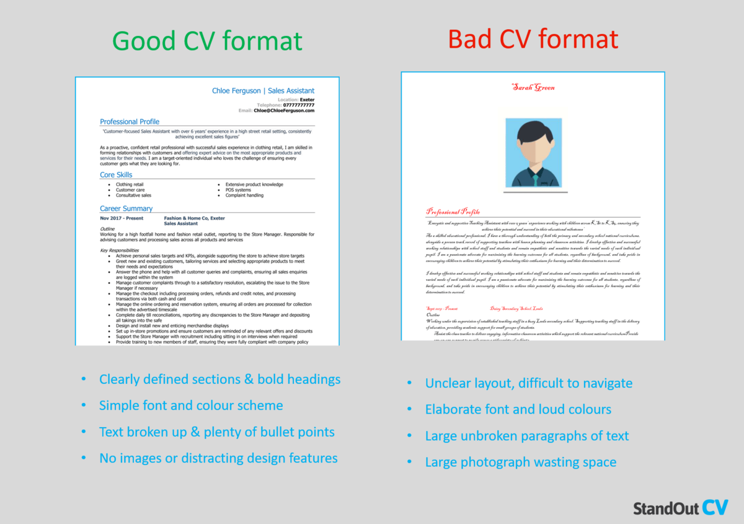

Slide 13
Questions?

